Slide 1




CHALLENGE 14
RISK MANAGEMENT INSIGHT

Slide 2




MEET TEAM RISKY BUSINESS
TEAM CAPTAIN:
ALEX COLES
DANNY HORROCKS
JOHN SISK & SON
JOHN SISK & SON
HELEN SU
KATE ATKIN
BMT
BMT
Notes:
We are Team Risky Business working together on Challenge 14 with Alex and Danny from John Sisk and Son, and Helen and Kate from BMT.

Slide 3
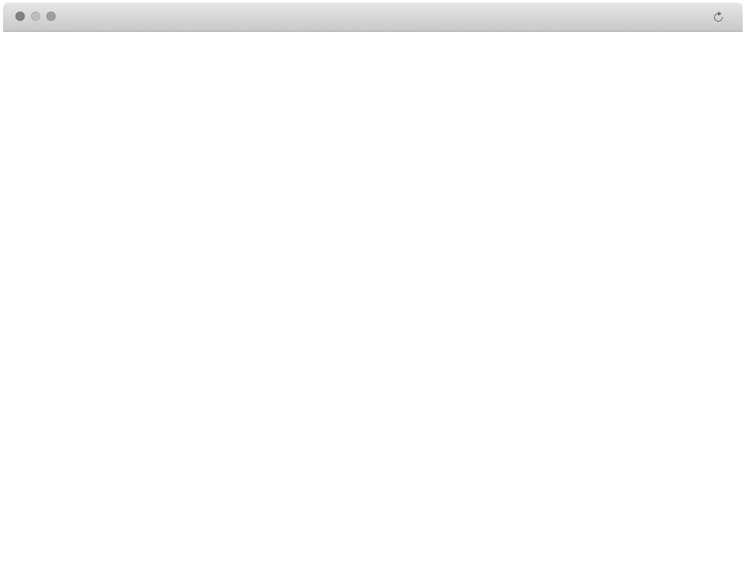
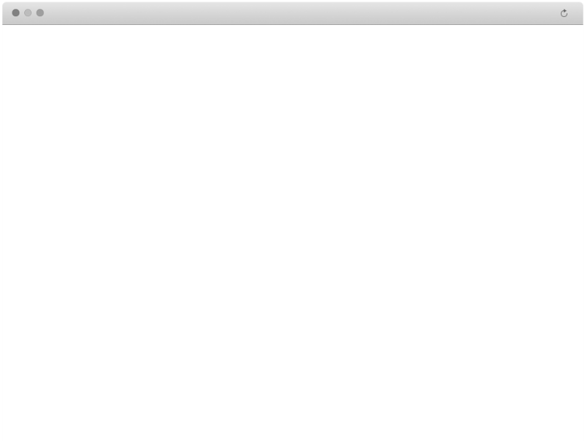



CHALLENGE OVERVIEW
An overview of Challenge 14
At HS2 there are large portfolios of projects happening at any one time.
Ensuring that risks management is at the heart of the programme execution is necessary to ensure that any potential problems within a project are accounted for, and necessary steps are taken in order to mitigate that risk so that the process is robust and resilient.
Can insights on existing risk registers provide a view on how risks are identified and managed and also provide recommendations on process improvement to ensure that projects are delivered on time, on budget and to the highest possible standard?
Notes:
This challenge is submitted by HS2 to improve the risk management process and improve the ability to analyse risk data.

Slide 4



PAIN POINTS & USER STORIES
We need a tool that allows us to:
Educate on the impact of incomplete assigned risk response action and learning lessons from historical risk data.
Socialise the risk impact analysis across the wider organisation to encourage engagement
Develop global risk registers, risk catalogues and learning from existing risks
Ensure the team is engaged and informed on their risk management
Minimise number of redundant risks and decrease time spent to produce risks
Improve the quality of risk information within the risk register database
1. Senior Decision Makers
A. Overall Risk Management | Understand how well risks are being managed across the project
B. Risk Assessment Quality | See data that gives confidence in the risk assessments
C. Intervention Requirements | Identify where I can intervene to ensure all projects are delivered with resilience
2. Risk Manager
A. Efficient Process | Make the risk management process as efficient as possible
B. Improved Risk Capture | Ensure that all risks are adequately captured
C. Assignment & Monitoring | Ensure that risks are identified, assigned and monitored in a timely manner
3. Risk Owner (inc. Contractors)
A. Visibility & Support | Ensure my risks are receiving appropriate attention to allow support to be provided
B. Risk Mitigation & Actions | Minimise likelihood and impact an ensure I can take necessary precautions to ensure delivery
C. Benchmarking | Allow me to benchmark performance against other similar projects
Notes:
We sought to develop a tool that addresses the requirements from the pain points and user stories which will:
Ensure the team is engaged and informed on their risk management
Develop global risk registers, catalogues and learning from existing risks
Educate on the impact of incomplete assigned risk response action,
Socialise the risk impact analysis across the wider organisation to encourage engagement and improve the quality of risk information within the risk database
And this will address the requirements of the users of the senior decision makers, risk managers and risk owner.
We took on board some pain points and user stories in order to shape our user requirements. Through stakeholder analysis we have provided 9 requirements across three different users which is highlighted on the table, some of which include overall risk management, improved risk capture and risk mitigation and actions.

Slide 5








OUR TOOLS
Risk Register stored in Spreadsheets
Old Process
Notify when changes have occurred
New Process
Store risk data in a collaborative shared environment
Visualise the risk landscape across the project
Modify risks as changes occur to allow dynamic management
Allow risks to be proposed by all to drive engagement and ownership
Notes:
At present as with many risk registers the current process is based around an Excel spreadsheet, which is often not widely accessible to the team and remains unread in a drawer. Our approach has been to utilise the Microsoft power platforms, to use a combination of tools as shown. We used Forms for data input, SharePoint for data storage, Outlook for notifications, Power BI for data visualisations, Power Apps for dynamic data management. Power Automate links all these tools together.

Slide 6
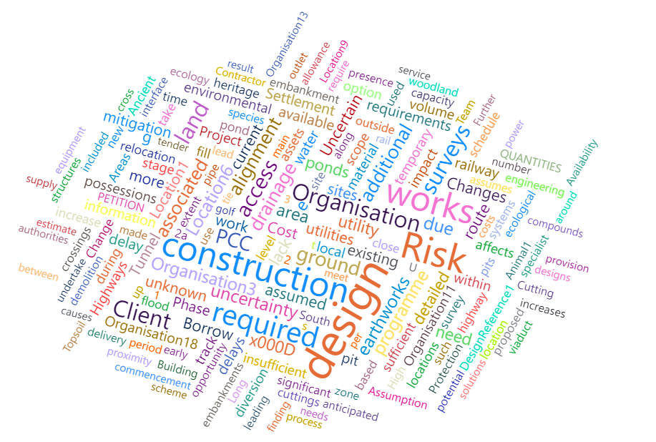






DATA INPUTS
Data Fields Provided
Risk Title | Close Action | Business Unit: Organisation Managing Register
Owning Joint Venture | Consequences | Current Impact
Risk Manager | Current Rating | Detailed Description of Risk
Risk Owner | Forecast Rating
Status | Risk Type
COST
Best Web Development
ENVIRONMENT
SAFETY
DELAY
DESIGN
Recommended New Data Fields
Key Dates: Date of Entry / Risk Start Date / Risk Duration
Sub Contractor (where relevant)
Location Information: Works Section / Longitude & Latitude
Works Type Description
Critical Path Delay
Categories: Cost / Delay / Safety / Environment / Design
Notes:
From the data provided we developed a word cloud using Power BI, which identified 5 key impact factors as shown. A scoring system was developed with input from the HS2 team which will be shown later in the presentation. We also recommended new data fields to be added to the risk management system.
We began by creating a form to improve data quality and make the inputting of risks more accessible and straight forward.

Slide 7

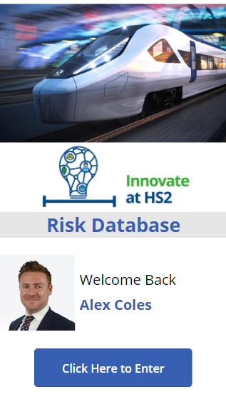


POWER APP
Selected PowerApps to drive engagement with the dataset
Move away from a static Excel spreadsheet “in a drawer” to a dynamic and targeted database
Personalization to the User
Integration with SharePoint Database and PowerBI Dashboard
Mobile-Based Platform

Slide 8
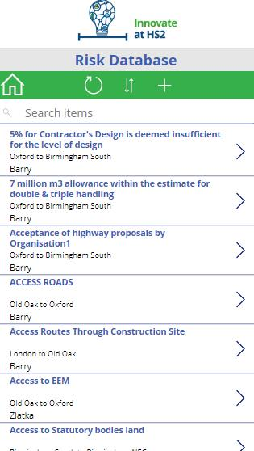
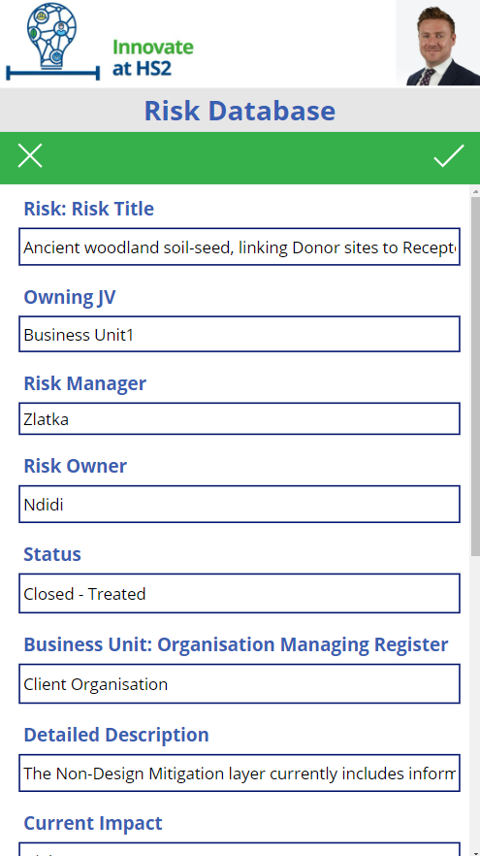





POWER APP
Identify, Capture, Assign and Monitor Risks in a Timely Manner
Provide Visibility of All Risk Management
Improve the Quality of Risk Information Within the Database
Ensure Each Risk Receives Appropriate Attention
Edit risks as required to allow more dynamic and real-time information
Notes:
Identify, capture, assign and monitor risks in a timely manner
List of risks provided in the app, with the ability to view and edit the details of each risk
2. Each risk receives appropriate attention
Ease of use in the app ensures that each individual risk will be easier to view and manage, along with the automation of email update when a risk is changed.
3. See how each risk is being managed
All risks completed in Microsoft Forms will automatically log in SharePoint, and therefore also in the PowerApp. Risks can therefore be added and managed through the app (increased ease of use).
4. Improving the quality of risk information within the Risk Register database
Risks can be edited through the Power App, both if they were created in Microsoft Forms or on the app,. This avoids the duplication of risks and unnecessary information being recorded as the categories are already specified.

Slide 9
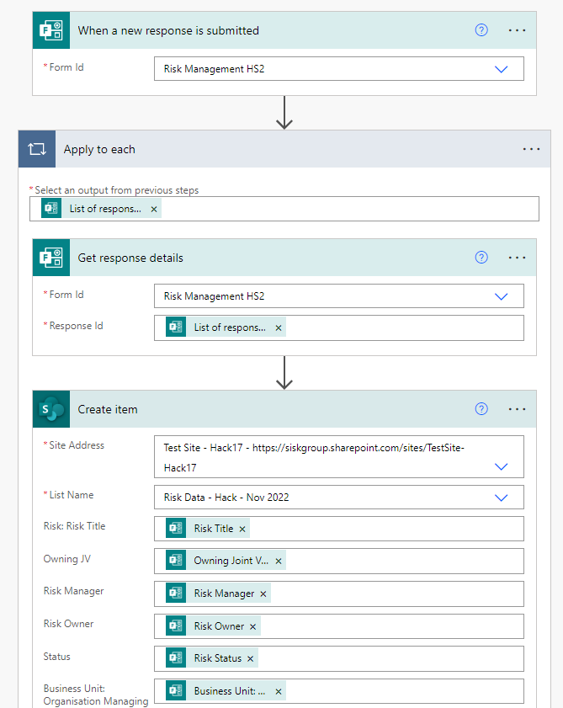
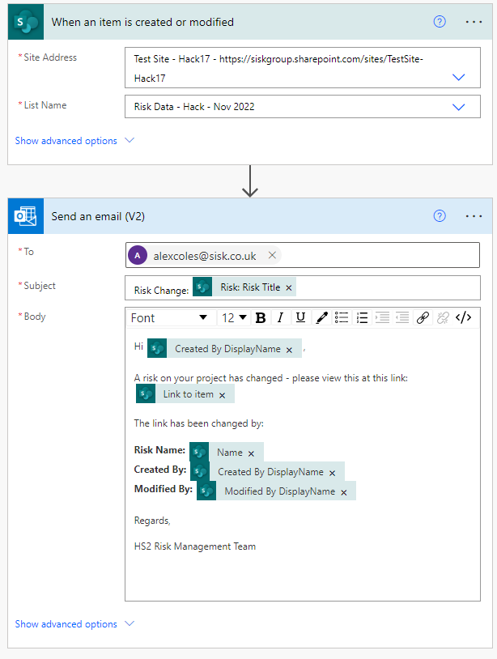
POWER AUTOMATE
Several Automated Flows have been developed to link tools together:
MS Forms > SharePoint
Every time a Form is submitted it is automatically added to the database
Power Apps > MS SharePoint > Outlook
Any changes in the SharePoint database via the PowerApp will result in an update Email to the Risk Owners

Slide 10
DASHBOARD

Slide 11
JUDGE’S QUESTIONS
Question 1
Question 2
Question 3
How have you minimised the number of redundant risks in the register?
Have you found any data quality issues and how have you addressed them?
How have you presented the impact of risks being realised against project milestones / objectives being achieved?
Notes:
Q1: It would be dangerous to remove risks with an automated process without a knowledge of the project. We have increased visibility and accessibility of the data set, which will facilitate appropriate owners minimising redundant risks.
Q2: The data was of reasonable quality but limited. We believed that full risk analysis was not possible without additional data being captured which is why we suggested the additional fields.
Q3: We have increased the breadth of impact categories and also provided more tangible data around cost and risk that provide a numerical figure against each risk.

Slide 12



SOLUTION BENEFITS
DECISION MAKING POWER
REDUCE BURDEN
OVERALL BENEFIT
1
3
5
OVERALL IMPROVEMENTS
2
4
IMPROVE CLARITY
2
4
Risk Owner | Requirement | MS Forms | Power App | Power BI | Power Automate
1. Senior Decision Makers | A. Risk Management |  | ü | ü
 | B. Risk Assessment Quality | ü | ü
 | C. Intervention Requirements |  |  | ü
2. Risk Manager | A. Efficient Process |  |  |  | ü
 | B. Improved Capture | ü | ü
 | C. Assigment and Monitoring |  |  | ü
3. Risk Owner (inc. Contractors) | A. Visibility and Support |  | ü | ü
 | B. Risk Mitigation |  |  | ü
 | C. Benchmarking | See next steps

Slide 13

NEXT STEPS AND RECOMMENDATIONS
GOVERNANCE
BENCHMARKING
Currently, anyone can raise a risk. The next step is to create a Power Automate to ensure that every time a risk is created, the risk manager is notified to approve the risk
The contractor wants to benchmark against similar or historic projects, which can be done using nPlan or a similar platform.
DYNAMIC RISK MODELLING
REMINDERS
Dynamic risk modelling would allow more flexibilities on probabilities in the Power BI Dashboard
Potential to automate email reminders about the risk, such as start date and ensuring the risk is kept up to date
Notes:
Governance – anyone can raise a risk etc, can create a power automate so that every time a risk is created, the risk manager is notified to approve
Dynamic risk modelling – to allow more flexibility on probabilities

